Slide 1


Modeling User Activities in a Large IPTV System
Tongqing Qiu, Jun (Jim) Xu (Georgia Tech)
Zihui Ge, Seungjoon Lee, Jia Wang, Qi Zhao (AT&T Lab – Research)

Slide 2
Motivation
Rapid deployment of IPTV
  Triple-play package
  Interactive capability and functional flexibility
System design and engineering tasks for IPTV
  E.g. evaluation of design options, system parameter tuning
  Highly related to impact of the user activities
State of the art
  Conventional TV: no strong need
  Unrealistic model (e.g. fixed rate Poisson)
  Directly use real trace?
Our goal
  Realistic workload generator
2
Notes:
In the recent years, IPTV emerges as a new distribution way for TV program. On the one hand, there is a global trend among the telecommunication companies on the rapid deployment of IPTV services. On the other hand, a comprehensively understanding user activities in IPTV lag behind.
Although commercial TV distribution networks (e.g., cable, satellite) have prevailed for decades, to the best of our knowledge, no detailed study on modeling individual users’ TV watching activities is available in the literature. Maybe the company did the study but it is not public available. This also might be partially because there has not been a strong need, as data flows in conventional TV networks are typically limited to the downstream direction from servers to set-top boxes (STBs), and user channel switching has very little system-wide impact.
In IPTV systems, by contrast, an understanding of user activities is essential to many system design and engineering tasks such as evaluation of various design options, optimal system parameter tuning, improving customer care, and defining effective system care procedures to minimize service impact

Slide 3
Our Contributions
Investigation of the user activities
A series of mathematic models to capture underlying process
Workload generator SIMULWATCH
  A small number of parameters as input
  Generate realistic trace
  Not a predictor
3
Notes:
Because of the strong requirement of user activities studies in IPTV system, it is the topic of our paper. More specifically, we have the following contributions.
First, we present in-depth analysis results based on data traces from a nation-wide operational IPTV system. We identify many interesting characteristics. For example, we find that user activities (such as channel switching) are often correlated, hence the aggregate activities are much more bursty than the outcome of a fixed-rate Poisson model that many previous studies assume. In this part, some observations are overlapped with last years’ IMC paper. But we did two steps further. First, we develop a series of models that capture these intrinsic characteristics on each of the attributes. We use the mixture exponential distribution to model vari- ous session duration distributions. To characterize the time- varying nature of user activities, we apply Fourier Transform and model the periodically correlated events. use exponential distribution to characterize channel access popularity. Combined all these separate models, we construct a workload generation tool, namely SIMULWATCH. It takes a small number of parameters as input and outputs a series of synthetic user traces that mimic a set of real users watching IPTV.

Slide 4
Roadmap
IPTV architecture overview & data set
Empirical observation and modeling
Workload generator
Conclusion
4
Notes:
First, we
provide an overview of the IPTV system and the data set used in
this study. Second, we selectively present our empirical measurements which are related to our model construction and how to model them separately. Third, we combine separate models together to construct a workload generator and finally make a conclusion.

Slide 5
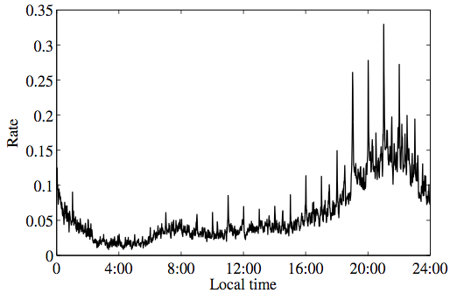
Q1: Timing to turn on/off/ switch the channel
Strong time-of-day effect
Bursty around hour or half hour boundaries (not fixed
rate Poisson)
Time varying channel switching rate (per minute)
5
Notes:
Next, we want to answer Q2, when to switch the channel. Note that session length distribution can partially answer the question.
Figure shows a one-day time series of the event rate for the channel switching events. Plots are shown in one-minute precision. Here the event rate is the number of switching events during the interval normalized by the total number of on-line STBs at the beginning of the interval. there is a strong time-of-day effect in both figures. More interestingly, we observe that both event rate series are very bursty, with significant spikes aligning closely with hour or half-hour boundaries (it is more pronounced in Figure 4b). This is due to the fact that most TV programs are aligned to hour boundaries.

Slide 6
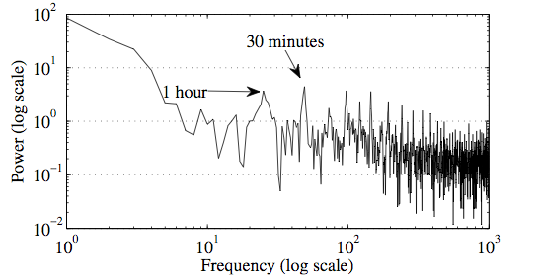
Model the time varying part: FFT
Weibull distribution to capture the general trend.
Replace (limited number of) bursty points with observation values .
6
Notes:
So how to model the time varying part? It is relatively hard when observing time domain. So we apply fast Fourier transform (FFT) to the event time series and present the result in Figure 9. The structure, in all cases, suddenly becomes very clear – there are a few of distinct spikes at frequencies that correspond to 1 hour, 30 minutes, 15 minutes etc., and an ambient gradual decrease in the power level (y-axis) from low to high frequencies.

Slide 7
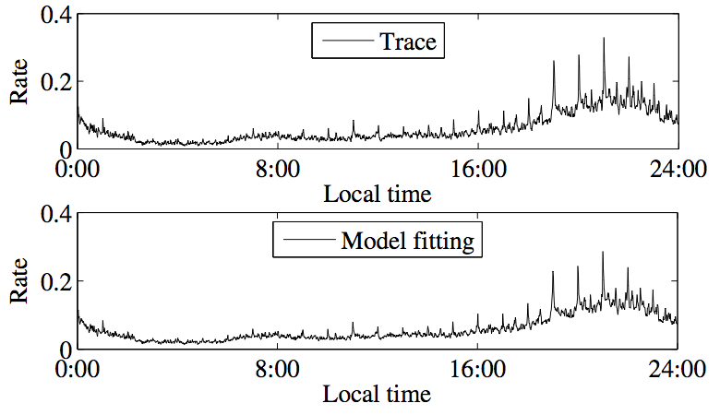
Modeling the time varying part (cont.)
5 parameters used
7
Notes:
Figure 10 compares the result from the real trace (top) and the result from our model (bottom). We find that they match very well, even when we use only 13 parameters here (k, μ and the value for the 2-3 spikes in Table 2).

Slide 8


Modeling the time varying part (cont.)
Rate moderating function g(t)
  Directly scaled from the aforementioned curves
  Properties:
    Time of day property
    Normalization
  W is 86, 400 seconds, or 1 day
8
Notes:
After sucessfully model the event rate curves, we introduce a rate moderating function g(t), which directly derived from the aforementioned curves.

Slide 9
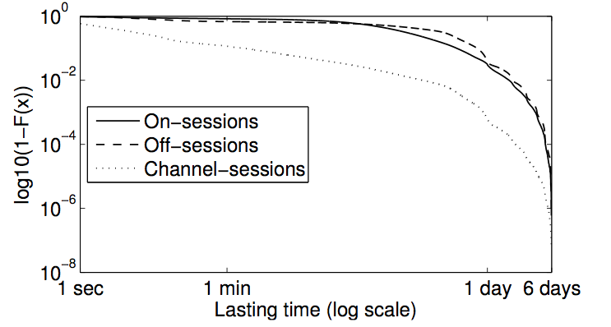
Q2: How long to stay on/off/tuned on a channel?
~ 5% of the on-sessions and off-sessions are over 1 day
－ Very long tail
－ Off-session has a heavier tail than the on-session
CCDF of session lengths
9
Notes:
Figure 2 shows the complementary cumulative distribution function (CCDF) of the length of on- and off-sessions. Using CCDF, we can better illustrate the tail property of the distributions. off-session has a heavier tail than the on-session. This matches our intuition since it is more likely that an IPTV user leaves the TV off for a long time (several days) than leaving the TV on.

Slide 10
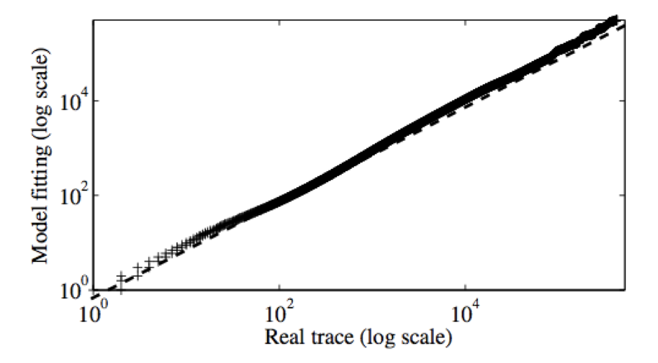
Model Session Length Distribution
Mixture Exponential Model
Parameter Estimation (EM, MLE)
Insights
  e.g. Channel-sessions n=3
    three states: surfing, watching and idle
    1/λi (inter arrival time)： 30sec, 40 min and 5 hours
10
Notes:
This model has been widely applied due to its simple form and its capability in approximating tail behavior. Moreover, it can provide some insights to explain the users’ activities. This formula shows the probability density function. It can be viewed as n different exponential distributions, lamda is the rate paramter, a is the weighting factor, with summation of 1. To estimate the parameters, we apply expectation Maximization (EM) algorithm [4] to find the maximum likelihood estimate (MLE) for the parameters.

Slide 11
Q3: Switch to which channel?
Sequential-scanning vs. target-switching
  56% vs. 44%
  Sequential scanning is lower than our expectation
Sequential scanning
  Up vs. Down: 2:1
Target switching
  ?
11
Notes:
The final question is switch to channel. In order to answer this question, we first divide the channel switch events into two parts, sequential scanning and target-switching. From the data we collected, we observe that 56% of channel switching events are sequential-scanning. This is a little bit lower than our expectation. We find that the high ratio of target switching can be attributed to many advanced features that the IPTV provider supports, including a user-customized favorite-channel list, a pro- gram menu where users can browse and switch channels by name, and an easy access to DVR.
For sequential scanning, We observe an unbalanced up- and down-channel-switches – 72% of them are up-channel-switches. It implies that more people prefer increasing channel number.

Slide 12
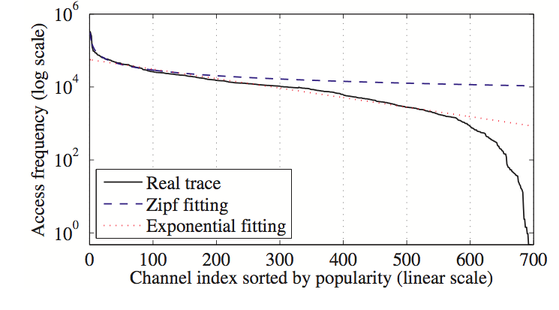
Model Channel Popularity (Target Switching)
12
Notes:
Solid line shows the the channel popularity of target switching events. x is the channels sorted by their popularity, and y is the number of times that channel being accessed. as log scale. How to model this distribution? We find that a single model cannot watch it very well. Particulary, Zipf fitting can match well for the top 100 channels. But exponential fitting can match well in from 100 to 600 channels. What we do is to use the hybrid model to much the different parts of the curves. Note both curves cannot much the last 100 channels very well. However, we can safely overlook it because it can only account for less 3% of access frequency, which has small impact of the system.

Slide 13
Roadmap
IPTV architecture overview & data collection
Empirical observation and modeling
Workload generator
Conclusion
13
Notes:
After preseting the observations and modes, we want to introduce our workload generator which combines these models together.

Slide 14

Workload Generator SIMULWATCH
Event-driven simulator
  Timing to turn on and off
  Timing to switch channel
  Switch to which channel
Branching probability
Base rate
Moderating function
OFF1
ON1
OFF2
ON2

Slide 15
Performance Evaluation
Settings
  2 millions STBs and 700 channels
  One day synthetic trace
  Compare with real trace on a date (different from training data)
Comparison
  Properties that we explicitly model
  Properties that we do not explicitly model
  A case study

Slide 16
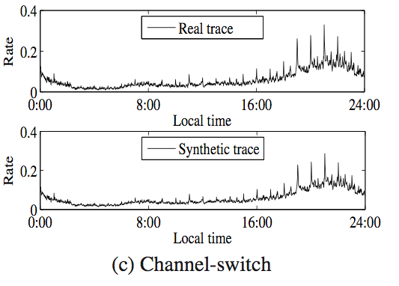
Properties Explicitly Modeled - Example

Slide 17
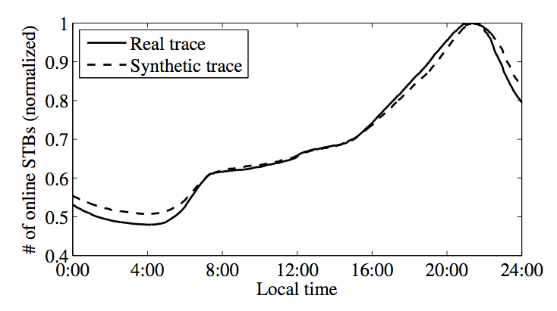
Properties not explicitly modeled
17
Notes:
Figure 17 shows the average number of on-line STBs as a function of the time-of-day. We normalize both synthetic trace and real trace such that the value at their peak time is 1. This is a property that we do not model directly, however, we still find a decent match in their shape.

Slide 18
Case Study
Consider single router in one VHO, 2000+ users connected
Evaluate the bandwidth requirement for a router
Bandwidth
  Simultaneous multicast streams
  Simultaneous unicast streams
18
Notes:
Since our ultimate goal is to use the synthetic trace from SIMULWATCH in evaluating the performance of different design of IPTV system, different system parameter settings, etc., we put SIMULWATCH to a final test by using it in a case study.
In partic- ular, we are interested in evaluating the bandwidth requirement to support fast-channel-switch. Recall that using fast-channel-switch, a short (x seconds) unicast stream is transmitted to the STB (in ad- dition to a new multicast stream) when a user switches to a new channel.
We focus on a single router in one of the VHOs in the IPTV network, which connects to 2, 137 downstream STBs.

Slide 19
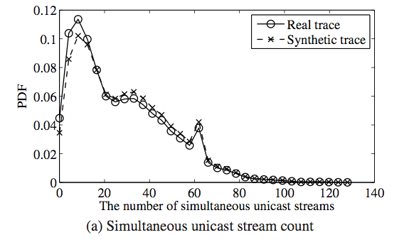
Case Study - Unicast
correlated channel switches at hour boundaries
19
Notes:
Figure 21a shows the distribution density function on the number of concurrent unicast streams when using either real trace or syn- thetic trace in evaluation. We observe that the two curves closely match. Both curves show that for around 4% of time there is no unicast stream in the system; with a small probability, there can be demand for more than 80 concurrent unicast streams, with the maximum being 128 in both cases; and interestingly there are two local peaks (at 10 and 60) in both distribution functions, the second of which may relate to the correlated channel switchings at hour boundaries.

Slide 20
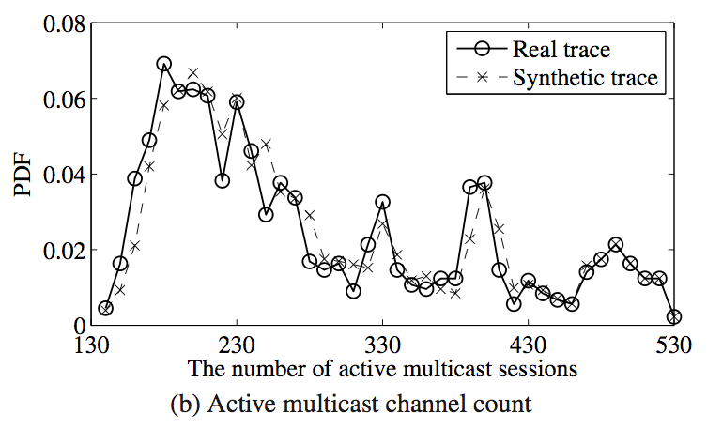
Case Study - Multicast

Slide 21
Other results
Multi-class modeling
  Different users have different preferences
  Stable stub groups
  Enhance our workload generator

Slide 22
Conclusion
In-depth analysis on
  Time varying event rate, session duration, channel popularity, etc.
Developed a series of models
  Mixture exponential model, Fourier transform, etc.
Construct a workload generator
  Limited number of parameters to generate realistic trace.
Future work
  DVR related behavior
  More interactive features
22

Slide 23
Thank you!
Questions?
23

