Slide 1
Modeling Channel Popularity Dynamics in a Large IPTV System
Tongqing Qiu, Jun (Jim) Xu
(Georgia Tech)
Zihui Ge, Seungjoon Lee, Jia Wang, Qi Zhao
(AT&T Lab – Research)
Sigmetrics 2009

Slide 2
Motivation
IPTV emerges a new distribution framework for TV
  Increasing widely deployed
  Not well studied
Compared to conventional broadcast TV, commercial IPTV uses unicast/multicast instead
  Channel popularity matters to system/network performance
Channel popularity distribution in a IPTV system
  How skewed?
  How stable?
  Stationary or any periodic patterns?
How to Model?
Notes:
In the recent years, IPTV emerges as a new distribution way for TV program. On the one hand, there is a global trend among the telecommunication companies on the rapid deployment of IPTV services. On the other hand, a comprehensively understanding the characteristics in IPTV lag behind.
Compared with traditional broadcast TV, IPTV use unicast/multicast instead.
Because of this delivery method, channel popularity has a great impact to both IPTV system and network performance.
So in this talk, we focus the channel popularity in a IPTV system. In particular, we want to answer the following question regarding channel popularity based on our measurement study: how skewed the distribution is, if we consider the dynamics of popularity, how stable of the popularity, is that a stationary process or any periodic patterns. These three questions can be answered in our measurement part. Moreover, we also try to model the popularity, including modeling the skewness of the distribution, modeling the stationary process and the existing patterns.
Why model is also important. Because using the model, we can build up workload generator tools, minicing users activtities, which is helpful for performance evaluation purpose.

Slide 3
Roadmap
IPTV architecture overview & data collection
Empirical measurement results of channel popularity
Modeling channel popularity
Multi-class population study
Conclusion
Notes:
First, we
provide an overview of the IPTV system and the data set used in
this study. Second, we present our analysis result on channel
popularity distribution and channel popularity time dynamic. Third, we present our stochastic model that captures these behaviors.
Then We extend our analysis to explore the presence of multiple classes of user population in the system and accordingly adapt our
Model.

Slide 4
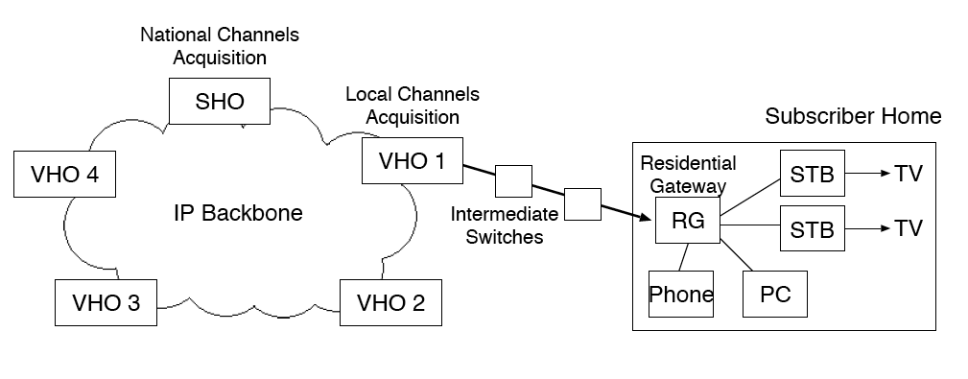
IPTV Architecture Overview
Note: we focus on large commercial IPTV system, rather than P2P based IPTV systems.
IP multicast
Unicast
  Due to the latency of channel switching
Notes:
Figure 1 shows a typical IPTV service system, in which live TV
streams are encoded in a series of IP packets and delivered to users
through the residential broadband access network. The SHO (Super Head-end Office), which is the primary source of television content,
digitally encodes video streams received externally (e.g., via satellite)
and transmits them to multiple VHOs (Video Head-end Offices)
through a high-speed IP backbone network. The VHOs, each
responsible for a metropolitan area, in turn acquire additional local
contents (e.g., local news), perform some further processing (e.g.,
advertisement insertion) and transmit the processed TV streams to
end users upon request. Inside a residential home, RG (Residential
Gateway) connects to a modem and one or more STBs (Set-
Top Boxes) with coaxial cable, receiving and forwarding all data,
including live TV streams, STB control traffic, VoIP and Internet
data traffic, into and out of the subscriber’s home.
In order to leverage the one-to-many feature of IPTV traffic, video streams from VHO to STB are transmitted using IP multicast. However, if only multicast, there would be a significant delay when switching channels, partially due to the management of multicast group using IGMP. In order to alleviate this problem, when a STB switch channel, there would be a temporary unicast between VHO to STB.

Slide 5
Data Set
A large-scale IPTV service provider in North America
  ~2,000,000 Set Top Boxes (STBs)
  ~500 channels
  One month data (June) in 2008
  Four time zones, we present the results in EDT
We construct user activities with respect to:
  Turning on/off STBs
  Switching channels
Limitation
  Short channel switching not recorded
Notes:
The data we use in this study are collected from a large-scale
IPTV service provider in the United States, which has close to one
million subscribers and over two millions STBs spreading in three
different time zones, carrying over 500 different live TV channels.
We have obtained subscribers’ STB logs, control plane messages,
network configuration data, and TV channel and program lists from
this service provider. We construct all user activities with respect
to turning on/off STBs, switching channels, and playing live or
recorded TV program by combining these data altogether. We associate
each of the user activities with its origin STB and a timestamp
(with the resolution of one second) in this study.
We have collected the aforementioned data for one month (June)
in 2008. To account for the time zone differences, we divide the
STBs into three groups, one for each time zone and study their
channel popularity properties separately. In the rest of the paper,
we will use the data from the Eastern time zone while the results
including the other time zones are quantitatively similar.

Slide 6
Two Metrics
Channel access frequency
  The number channel switching events to the channel
Channel dwell time
  The amount of time STBs stay tuned in the channel
Note: normalized among all channels
  The number of online STBs change overtime
Notes:
Channel popularity needs to be precisely defined before we can
present our analysis result. There are two common used metrics to
measuring the channel popularity. The first is based on channel access frequency which is defined as the number of channel switching
requests to the channel. The other is based on channel dwell time
defined as the amount of time STBs stay tuned in the channel. They
measure two different aspects of channel popularity: weighted by
visit frequency vs. weighted by watching time.

Slide 7
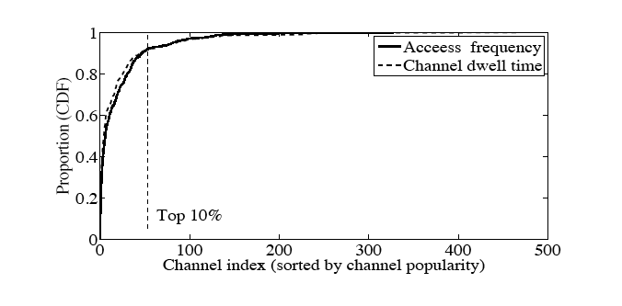
How Skewed -- Distribution of Channel Popularity
High skewness – the top 10% of channels account for 90% of channel access
Similar observation in other context, e.g. VoD, Youtube
Notes:
We first examine the long term distribution of channel popularity
(over the entire month) of all channels using both metrics. Figure 4
shows the cumulative distribution function (CDF) of channel popularity
ranked by access frequency and dwell time. We observe a
close match between the CDF curves of the two different popularity
metrics. Both distribution functions exhibit high skew.
To simplify
computation, in the rest of the paper, we focus only on the top 150
channels which account for over 98% of the channel accesses. We
acknowledge that modeling the tail part may be important for some
applications. However, this simplification should have little impact
on the analysis of overall time dynamics of channel popularity,
which is the main focus of the study.

Slide 8
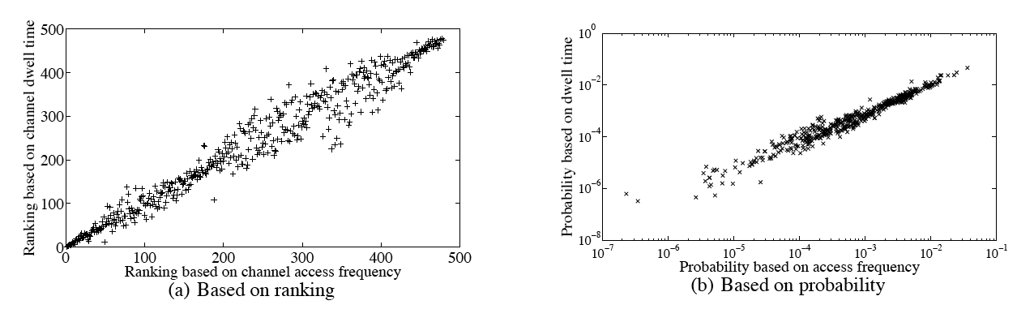
Strong Correlation between Channel Accesses and Channel Dwell Time
Reason 1: Limitation of our data.
Reason II: People are more likely to switch directly to the channel that they intend to watch. Possible reasons: relatively long delay during channel switches and the convenient TV guide.
Notes:
We have observed in the previous subsection that channel popularity
based on access frequency and based on dwell time produces
a very similar result. This may be an indication for a strong correlation
between these two popularity measures, which turns out to be
true as illustrated in Figure 7, based on the entire period of trace
In both figures, x is … y is … Each point represents one channel.
Figure (a) is based on ranking, so it shows the ranking position in both metrics.
In both figures, we find that the points are spread well
along the diagonal line

Slide 9
How Stable -- Time Series Analysis
Time series
  The probability to select one channel
Stationary analysis
  Methodology
    The nonparametric runs test
  Results
    At the 95-th percentile confidence interval, 92% of the channels pass the test (stationary process)
    The exceptions indicate the nontrivial pattern (diurnal patterns)
Coefficient of variation (CoV)
  0.60 for all channels (standard deviation = 0.013)
Notes:
We now turn our attention to the time dynamics of popularity for
individual channels. Because our measurement serves for modeling part. If we want to consider a stochastic model, it is natural to perform time
series analysis here. By time series series, we mean that the probability to select one particular channel, which can change over time.
To test the stationary of the channel popularity series, we apply
the nonparametric runs test
; At the 95-th percentile confidence interval, we find that 92% of the channels pass the stationarity test when aggregated at 15-minute
intervals. The stationary feature give us some hints to choose stocastic in the model part. A small number of channels that fail the runs test exhibit
non-trivial daily pattern, to which we will offer explanation later. It is also our motivation of multi-class study.
We also calculate the coefficient of variation (CoV) for the channel
popularity series. Despite the wide difference in their mean value, we find that the CoV’s of channel popularity
series are narrowly centered around 0.6. We will see how the
empirical CoV help for parameter estimation in our model in modeling part.

Slide 10

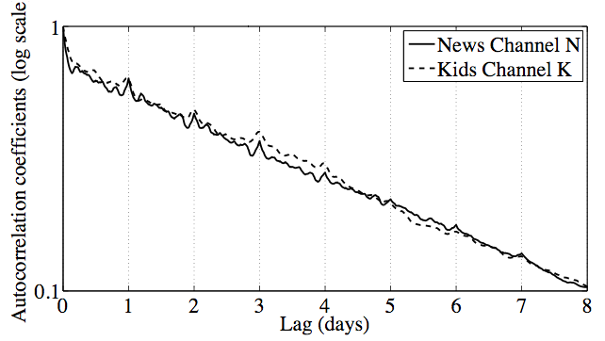
Time Series Analysis (cont.)
Autocorrelation
Diurnal patterns
Weekly patterns?
Exponential decreasing (a typical behavior in auto-regression processes)
Notes:
the ACF for the channel popularity series of the
kids channel and a news channel
The lag ranges from 15 minutes to 8 days. The roughly straight
lines indicate that the autocorrelation decays exponentially (note
the log scale in y-axis) as the time lag increases, a typical behavior
often observed in auto-regression processes.
besides the sharp decreasing trend, we also observe
small increases at the lags around day boundary (1 day, 2 days,
etc.). This implies that there indeed exist some diurnal patterns,
although minor, in the channel popularity. We address this issue in the multi-class part
One potential question is that we did not obverse very strong week patterns here.
One possible reason is that our data is collected summer, when some programs are daily based rather than weekly based.

Slide 11

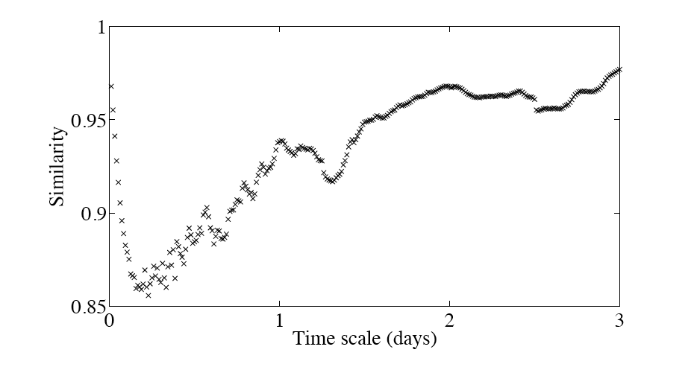
Multi-scale Property of Channel Popularity Similarity
Prediction
  Similarity between current time interval (minutes, days, etc.) to the next one
Cosine similarity
Determined by the TV program (shows) of the time.
Determined by the overall type of TV program on the channels.
Weakest predict arability of 3 ~ 4 hours window
Notes:
Another interesting angle for channel dynamics is the similarly. In particular, we are interested in the similarity between current minute to the next minute.
This study unveils the prediction ability of the channel dynamics. High similarity indicate the strong ability to predict the popluarity of next time interval
To quantify the similarity (or dissimilarity) of the channel popularity collectively among all
channels, we adopt the metric named cosine similarity. Cosine similarity
measures the similarity between two vectors by finding the
cosine value of the angle between them.
The value ranges from -1 to 1. The value close to 1 indicates higher similarity between A and B. Cosine similarity has been
widely used in high-dimensional data analysis such as applications in text mining
In the context of IPTV, we expect the channel popularity to be
relatively stable over time.
We discretize our data traces by fixed-interval time bins, with interval
lengths ranging from 15 minutes to 3 days. At each interval,
we calculate the channel access probability of different channels
for each time bin. Then, for each pair of adjacent time bins, we
compute the cosine similarity of channel popularity vectors. Based
on these values, we calculate the average for each aggregation interval.
we observe that the curve forms a V-shape as we increase
the aggregation level. Specifically, the similarity value first
decreases as the aggregation times increases, reaching its minimum
at around 3-4 hour aggregation scale. After that, we observe an increasing
trend as we increase the aggregation time scale
the similarity/dissimilarity of
the channel popularity is determined by the TV program (shows)
of the time. when the time scale is long, the
similarity/dissimilarity is determined by the overall type of TV program
on the channels.
Both the viewer base of individual TV shows
and the long term user affinity to the type of program are relatively
more stable,

Slide 12
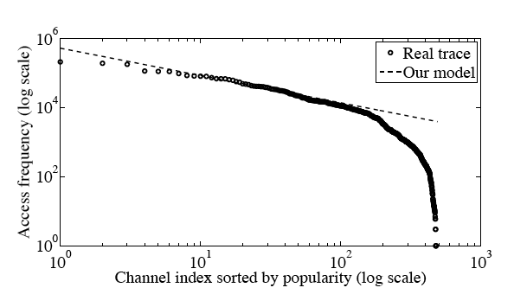

Modeling Channel Popularity Distribution
Recall observation:
  Highly skewed
Zipf-like model
  Success in Web, VoD, etc.
  An object of the rank i has the access probability
Top 100 accounts for over 95% of channel access
Notes:
We now present our model for channel popularity.
Recall that in the measurement part, we observe that popularity distribution is highly skewed.
How to capture such skewness.
The Zipf-like distribution has been proved successful in capturing
the skewness in content popularity such as Web [1] and VOD [17].
The definition of Zipf-like distirbution is that …
Figure 14 shows the access frequencies of all channels in the order of decreasing popularity
from the real trace and the fitted Zipf-like distribution (the dashed line with \alpha = 0.55

Slide 13

Modeling Popularity Dynamics
Recall dynamics observation
  Almost stationary
  Autocorrelation: exponential decay
Mean reversion model
  Match the observations
  Fluctuate but will revert to long-term equilibrium level
Mean reversion rate
Long-term mean
Volatility
Notes:
Recall that in measurement part, we have some dynamics observations: ….
These observations inspire us to look for a stochastic model, called mean reversion model.
Mean reversion model has been widely used in financial data analysis. It has some nice features which match well with our observation.
The basic idea is that the price of a stock or a commodity may fluctuate but will revert to its long-term equilibrium level

Slide 14

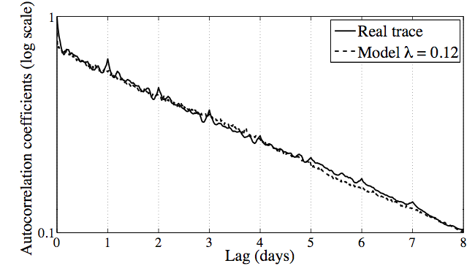


Modeling Popularity Dynamics (cont.)
Parameters estimation
  μ Derived from Zipf
  λ Autocorrelation fitting
  σ Derived form CoV
Notes:
Figure 15
shows the ACF of the news channel compared against the simulation
from the model with We observe a remarkable
match, with the exception of the surges at lags that are multiple
of one day

Slide 15
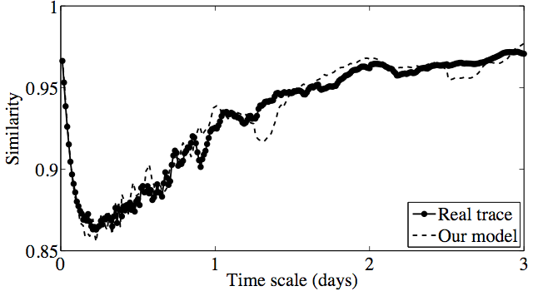
Modeling Dynamics -- Validation
Cosine similarity (“V” shape)
Notes:
shows that our model faithfully reproduce -shape behavior in the cosine similarity of channel popularity vectors.

Slide 16
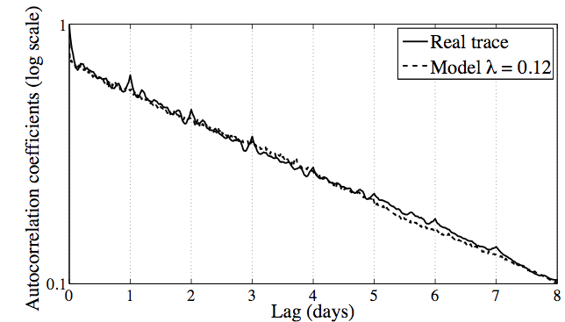
Modeling Dynamics – Validation (cont.)
Missing diurnal patterns
Notes:
In terms of autocorrelation, we found our model can capture the general trend, but missing many spikes

Slide 17
Multi-class Population Model
Previous model fails to capture diurnal pattern
  Users regularly change interest during time of day?
  Users with different interest tend to watch TV at different time of day?
Basic idea: subgroups (multi-class population)
  How to classify the users?
  How to select desired grouping method?
    Explain diurnal patterns
    Integrated to our model
  How to use multi-class population to extend the model?
Notes:
So far we have presented our analysis on the dynamics of channel
popularity and developed a mean reversion process to model
them. Although the model in the previous section works reasonably
well, it is incapable of capturing some diurnal patterns in the dynamics
such as the small increases around daily boundary in ACF.
We want to the study the reason behind this diurnal patterns. Is that because users will regularly change their interests during time of day?
Or it is because users with different interest tend to watch TV at different time of day? To answer these questions, a natural way of study is
subgroup study. That is we classify the users into different groups, then to understand the channel preferences in different groups.
The subgroups study involves the following three steps. First, we need to how to class the users. Then, among different kinds of grouping methods,
we want to identify the desired one. The method which can not only well explain the diurnal patterns but also can be easily utilized to extend our model.
Finally, after finding the grouping method, we will utilize it to extend our model to capture the diurnal patterns.

Slide 18
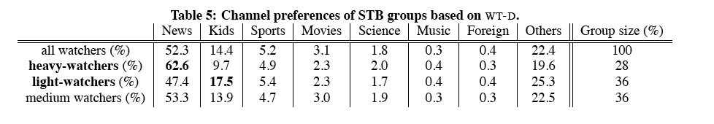
Desired Group Method
WT-D (daily watching time)
  Heavy-watchers (>12 hours) light-watchers (<2 hours) and medium-watchers
  Distinct channel preference between sub-groups
  User-to-group affiliation stable over time.
Notes:
Until now, we answers the question “how to classify the users”. The next question is that among all these grouping methods based on different grouping features, which one is the desired group method. The one can explain the diurnal pattern and can be used to extend our model.
I omit the details of select the desired group method due to time limitation. But the result is that WT-D is the best one we think. It has two nice features.
First, when grouping using WT-D, there are distinct channel preference between sub-groups. Second, user-to-group affiliation stable over time.

Slide 19
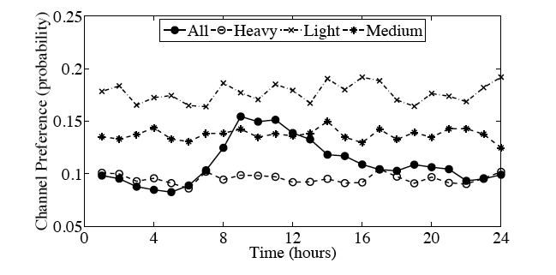
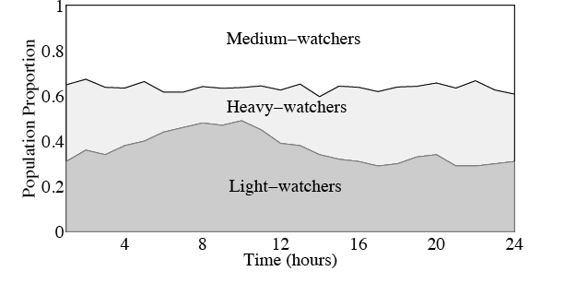
WT-D Can Explain Dynamics
Notes:
To convince you that WT-D can explain the dynamics time of day, especially the diurnal patterns
First, let’s look at this figure. It shows the users preference to one kids channel. There are four curves here.
Three of them are heavy-, light- and medium watchers based WT-D. The other one is the all watchers.
We find that the three sub-group cuves are relatively stable, but the all watchers curves has a peak between 8am and noon.
To explain this, let’s look at another figure. This figure shows the population proportion mix during time of day.
We observe that there is strong correlation between channel popularity change and population mix change.
the overall channel access probability for kids channels peaks between 8am and noon.
This coincides with the population gain by light-watchers during that time.

Slide 20
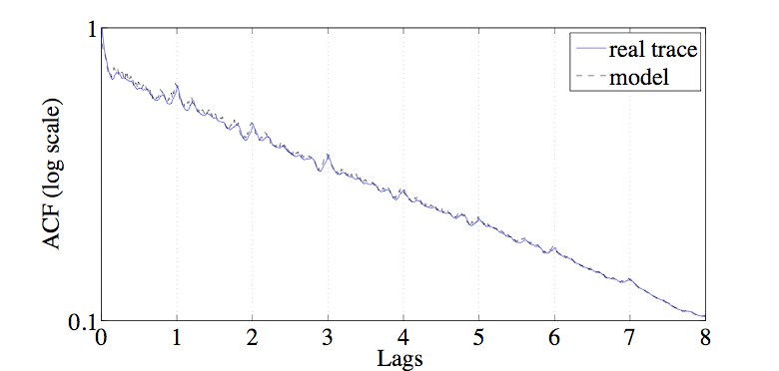

WD-T can Extend the Model
Multi-class population model
  Derive the popularity of ith channel based on ith channel, jth subgroup
Notes:
Next we will show that WD-T can be used to extend our model. Now we don’t consider the channel popularity dynamics for all watchers simply from mean reversion model. Instead, we consider that popularity of ith channel based on ith Channel, jth subgroup, described in the following formula. X_i is… X_{ij}. The W
is the results we observe the population portion figure. If using this model, when comparing the ACF of real trace and the model. We find that they matches better. If we compute the MSE between trace and model, we find the multi-class population model is one order of magtituge smaller than that of single-class model. There are other comparison between single-class and multi-class population model. Refer the paper for details

Slide 21
Conclusion
Measure and model channel popularity
Model popularity distribution and dynamics
  Zipf-like
  Mean reversion process
Multi-class study
  Develop a method for identifying groups of users
  Combine this grouping and the change of population mix to obtain a multi-class population model.

Slide 22
Thank you!
Questions?

